Slide 1

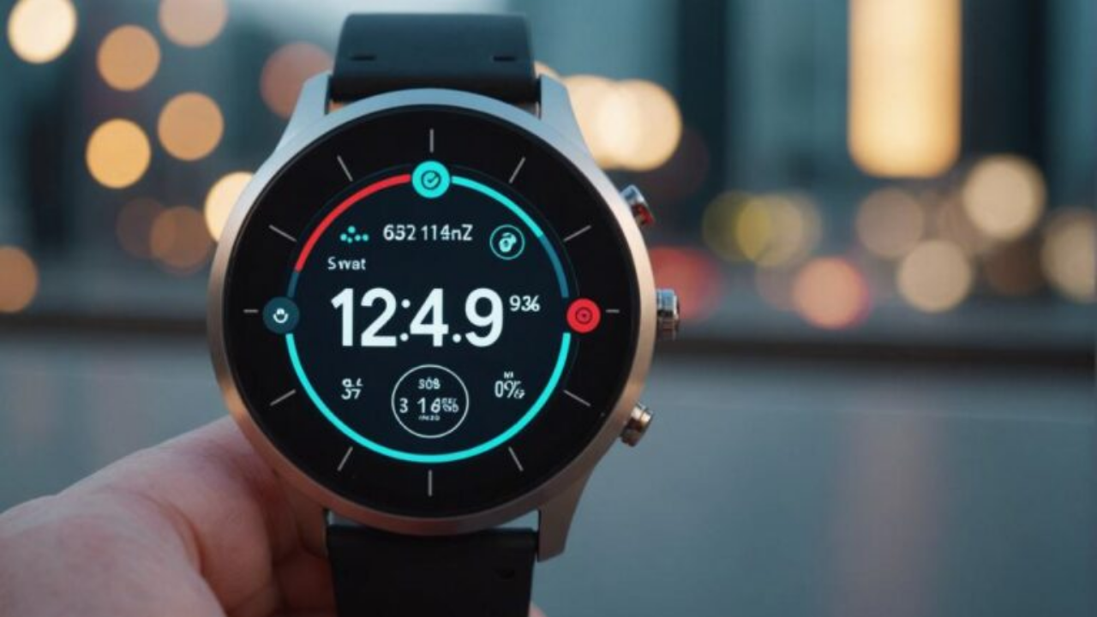



BioAge Life: Insurance That Rewards How You Live
The future of insurance is dynamic, personalized, and behavior-driven
"What if your insurance premium dropped every time you made a healthy decision?"

Slide 2









The Problem: Traditional Insurance is Broken
$2.8T
US Life Insurance Market
VS
Alex, Marathon Runner
Jordan, Sedentary
45 years old Excellent health metrics Active lifestyle
30 years old Poor health metrics Inactive lifestyle
Chronological age pricing ignores actual health status
$383
$285
Monthly Premium
Monthly Premium
A 45-year-old marathon runner pays MORE than a 30-year-old sedentary smoker
Premiums are STATIC — no incentive to improve health

Slide 3



Market Opportunity: The Longevity Economy Explosion
400M+
$746B
86%
WEARABLE USERS
2026 MARKET SIZE
MILLENNIALS READY
Real-Time Health Data
Longevity Economy
Health-Based Pricing
Apple Watch, Oura Ring, and Whoop provide 24/7 biometric data making dynamic underwriting technically feasible
Growing at 8.6% CAGR through 2036. Consumers want to "stay younger" longer - BioAge is the most compelling health metric
Open to health-based insurance pricing with 19.5% YoY InsurTech funding growth in 2025
Major insurers already partnering with wearables: Essence Healthcare offering free Oura Rings to Medicare members

Slide 4

Our Story: Why BioAge Life Exists
"We saw brilliant, health-conscious professionals paying the same insurance premiums as their unhealthy peers. Traditional actuarial models were punishing discipline instead of rewarding it. We knew technology could fix this broken system."
BioAge Life Founding Team
Insurance, Data Science & Health Technology Experts

Slide 5








Our Solution: BioAge Life Dynamic Underwriting
We replace chronological age with biological age using real-time biomarkers to create fair, incentivized insurance pricing.
CORE FORMULA
BA = CA + ΔHRV + ΔVO₂ + ΔSleep
Live Calculation Demo
Biological Age calculated from continuous health data
HRV
VO₂ MAX
SLEEP SCORE
Real-Time Biomarkers
High
54
85
HRV, VO₂ Max, Sleep from wearables
Chronological Age:
45 years
Dynamic Monthly Pricing
Biological Age:
32 years
Premiums adjust based on biology
Monthly Premium:
$71 (20% discount)
Behavioral Incentives
Gamification drives health improvement

Slide 6








Case Study: Real User Impact & Savings
TRADITIONAL MODEL
BIOAGE MODEL
Age-Based Only
Health Optimized
FAIR PRICING BASED ON BIOLOGICAL AGE
OPTIMIZED
45 → 32 BioAge
PREMATURE
30 → 38 BioAge
IMPROVING
55 → 50 BioAge
Alex
Jordan
Sarah
Athlete Lifestyle
Executive Stress
Health Journey
HRV/VO2 Max
85/54
HRV/VO2 Max
30/32
HRV/VO2 Max
62/45
Sleep Score
92
Sleep Score
55
Sleep Score
81
Monthly Premium
$71.10
Monthly Premium
$95.40
Monthly Premium
$138.20
Saves $18.90
+$35.40
Opportunity
VS TRADITIONAL
FAIR HEALTH COST
IMPROVING HEALTH

Slide 7




Business Model: Multiple Revenue Streams
Revenue Targets
85%
10%
$10M
Premium Revenue
Technology Licensing
ARR by Year 2
Monthly insurance premiums with dynamic pricing advantage
License proprietary underwriting engine to traditional insurers
(avg $95/user)
B2B partnerships
10K+
Target Users
3%
2%
2-3
Wellness Affiliates
Data Insights
Major Insurer Partnerships
Partner revenue from health optimization products
Anonymized longevity insights to pharma/research
Risk-based pricing advantage using biological age vs chronological age creates sustainable competitive moat
Strategic partnerships
Optional upside

Slide 8






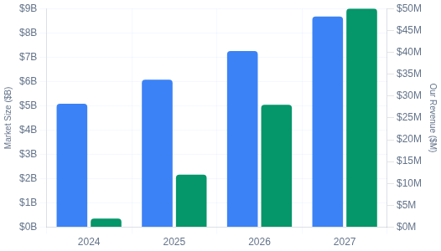
REVENUE STRATEGY
Business Model & Revenue Projections
B2B2C Partnership Model
2-3%
$101.6M
$50M
Licensing fees from insurance carrier premiums
Addressable market with 2% penetration target
Annual recurring revenue projection by 2030
Revenue Stream Breakdown
Market Penetration Timeline
Growth Target
2027
2028
2029
2030
Diversified B2B2C revenue model
Market Size
Our Revenue

Slide 9





Competitive Advantage & IP Protection
First-Mover Advantage
Patent-Pending Algorithms
Pioneer in biological age insurance underwriting with established market position and early customer adoption in the longevity economy.
Proprietary actuarial formulas for biological age calculation and dynamic premium pricing with patent-pending methodology protection.
Strategic Wearable Partnerships
Regulatory Framework
Established integrations with Apple Watch and Oura Ring providing 24/7 biometric data access for continuous underwriting capabilities.
Comprehensive compliance infrastructure and intellectual property protection strategy ensuring sustainable competitive moat.

Slide 10






Why We Win
Traditional Insurance
BioAge Life
Static underwriting models based on historical data and demographics
Real-time underwriting using continuous biomarker data
Annual policy reviews with limited customer touchpoints
Continuous engagement through wearable device integration
VS
Reactive claims processing after incidents occur
Behavior-driven risk reduction with health incentives
Age-based pricing that ignores actual health behaviors
Prevention-focused model that reduces loss ratios

Slide 11







Our Team: Why We're the Right Founders
Tzu-Ying Lee
Kwame Owusu Appiah Kubi
CEO & Co-Founder
VP Marketing
Insurance technology and risk management expertise with proven leadership in fintech innovation and actuarial science.
Harvard Business School Strategic Leadership credentials with extensive microfinance and financial services experience.
InsurTech
Risk Management
Actuarial Science
Harvard MBA
Strategic Leadership
Financial Services
Jehoshaphat T Abaya
Kwame Adu & Nicholas Odame
Chief Technology Officer
Technical Co-Founders
GSU, GT, MIT Professor in Health Informatics with extensive experience in Health Science and analytics.
Founders of Amazon and Tap2Pay, startup geniuses with experience in Gen A+ Tech solutions and AI for Good.
MIT Professor
Health Informatics
Data Analytics
Amazon Alumni
Fintech
AI/ML
Combined expertise in insurance, technology, and health sciences - the perfect foundation for revolutionizing InsurTech

Slide 12
BioAge Life
The Future of Insurance Is Personal
Live Demo: https://jatphat.github.io/InsurTech/
Questions?

